Slide 1
XGBoost
By Jiten Purswani, D12B/43

Slide 2
TABLE OF CONTENTS
Introduction to XGBoost
Core Concepts of XGBoost
Comparative Overview - XGBoost vs. Traditional Gradient Boosting
Comparative Overview - XGBoost vs. Random Forest
Key Parameters and Their Impact (XGBoost)
Experimental Comparison
Real-World Applications of XGBoost
Strengths & Limitations of XGBoost
Conclusion

Slide 3
INTRODUCTION:- WHAT IS XGBOOST?
XGBoost (Extreme Gradient Boosting) is an optimized, distributed gradient boosting library designed for efficient and scalable training of models.
It is known for its ability to handle large datasets and achieve state-of-the-art performance in both classification and regression tasks.
Key Features:
Efficient handling of missing values.
Parallel processing for faster model training.
High flexibility for tuning parameters

Slide 4
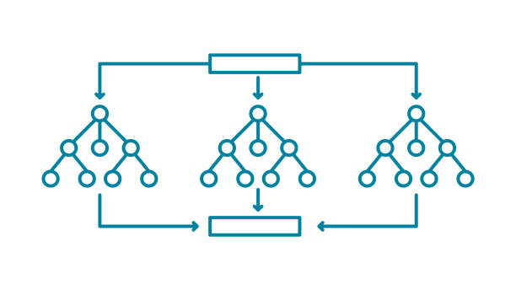
DECISION TREES
Structure: A flowchart-like tree where:
Internal nodes represent tests on attributes.
Branches represent the outcomes of those tests.
Leaf nodes represent class labels.
Recursive Partitioning:
The dataset is split into subsets based on attribute values.
The process continues until nodes contain homogenous values or further splitting adds no value.

Slide 5
BAGGING (BOOTSTRAP AGGREGATING)
An ensemble technique that combines predictions of multiple models trained on random subsets of the data.
Process: Each model is trained on a randomly sampled dataset (with replacement) from the original dataset.
Individual predictions are combined through voting (classification) or averaging (regression).
Benefits:
Reduces variance by averaging, making models more stable.
Helps to prevent overfitting while introducing some bias.

Slide 6
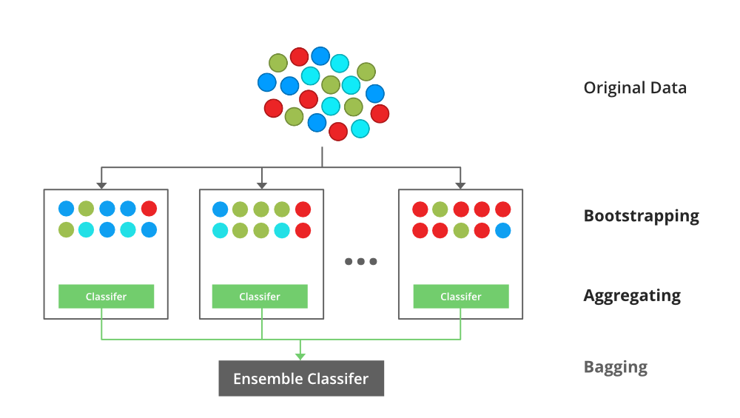
Source :- https://media.geeksforgeeks.org/wp-content/uploads/20210707140912/Bagging.png

Slide 7
RANDOM FOREST
An ensemble of decision trees trained using bagging and random feature selection.
Process:
Multiple Decision Trees are trained on bootstrapped datasets.
Each tree gives a prediction, and results are combined using majority voting (for classification) or averaging (for regression).
This process lowers variance, making the model more generalizable.
Bootstrap Sampling: Randomly selects rows and columns, adding diversity among trees

Slide 8
BOOSTING
An ensemble technique that builds models sequentially, where each new model corrects the errors of the previous ones.
Process:
Starts with a base model and adds models that focus on correcting errors from previous models.
Models are trained in series, not parallel.
Continues until predictions are optimized or a maximum number of models is reached.
Gradient Boosting:
Uses residual errors to train the next model.
Unlike AdaBoost, which adjusts weights, Gradient Boosting focuses directly on minimizing the loss by using residuals from the previous model.
Base learners in gradient boosting are often CART (Classification and Regression Trees).

Slide 9
CORE CONCEPTS

Slide 10
1. Advanced Gradient Boosting:
Optimized for Speed and Performance: Unlike traditional gradient boosting, XGBoost is designed for high efficiency and scalability.
Second-Order Optimization: Uses both first-order (gradients) and second-order (Hessian) derivatives for better approximation of the loss function, leading to faster convergence.
2. Regularization:
L1 and L2 Regularization: Adds regularization terms to the objective function, which helps control the complexity of the model and prevents overfitting.
Difference from Traditional Gradient Boosting: Regularization in XGBoost is more robust, leading to better generalization performance on unseen data.
3. Parallelization: Unlike traditional gradient boosting, which constructs trees sequentially, XGBoost speeds up the training process by parallelizing the split-finding process. Uses a block structure for data, which enhances memory efficiency and allows for faster computation during training.

Slide 11
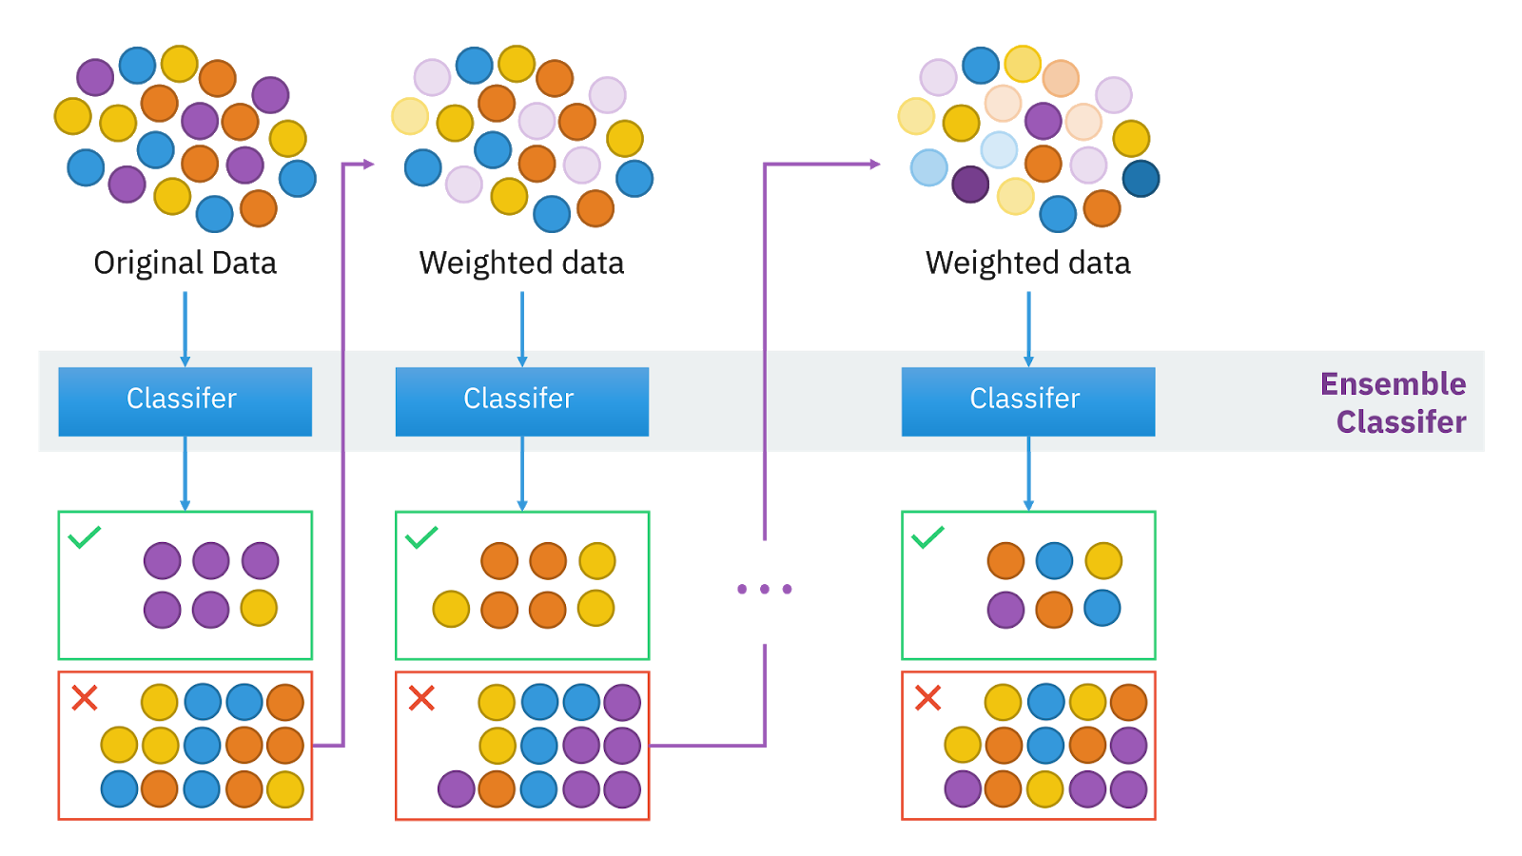
Source:- https://i0.wp.com/neptune.ai/wp-content/uploads/2022/10/Ensemble-algorithms-boosting.png?ssl=1

Slide 12
COMPARATIVE OVERVIEW:
XGBOOST vs TRADITIONAL GRADIENT BOOSTING

Slide 13
XGBOOST
Faster due to parallelized split finding and efficient use of resources, making it ideal for large datasets.
Built-in regularization (lambda for L2, alpha for L1) helps prevent overfitting, resulting in better generalization performance.
XGBoost offers parameters like colsample_bytree, subsample, and gamma for Customization
Traditional gradient boosting
Sequential and slower due to iterative training of each new model on residuals.
Tends to overfit if not properly tuned, as it lacks built-in regularization.
Customization mainly revolves around tree parameters (max_depth, learning_rate) and tree count.

Slide 14
COMPARATIVE OVERVIEW:
XGBOOST vs RANDOM FOREST

Slide 15
XGBOOST
Uses Boosting, where trees are trained sequentially.
Focuses on reducing bias by iteratively improving model predictions, which can lead to better accuracy
Uses regularization parameters (L1 and L2) to penalize tree complexity, helping to control overfitting and leading to better generalization.
Random Forest
Uses Bagging (Bootstrap Aggregating) where trees are trained independently in parallel.
Focuses on reducing variance by averaging multiple independent trees, making it robust to noise in the training data.
Typically less prone to overfitting due to averaging across multiple trees; does not have built-in regularization like L1 or L2 penalties.

Slide 16
KEY PARAMETERS AND THEIR IMPACT

Slide 17
Learning Rate (eta): Controls the contribution of each tree; lower values reduce overfitting but increase training time.
max_depth: Limits tree depth to prevent overfitting; deeper trees can capture more complex relationships.
subsample: Fraction of data used for each tree, reducing overfitting by using random samples.
Regularization (L1 and L2): Adds penalties to model complexity, improving generalization

Slide 18
EXPERIMENTAL COMPARISON

Slide 19
Google Colab demo link:- Colab

Slide 20
REAL WORLD APPLICATIONS

Slide 21
Why Choose XGBoost?
High performance with large datasets.
Customizable parameters allow for model optimization for different scenarios
Popular Use Cases:
Kaggle Competitions: Frequently ranks among the top due to fine-tuning capabilities.
Recommendation Systems: Used for predicting user preferences.
Click-Through Rate (CTR) Prediction: Effective in optimizing ad placement and online marketing.

Slide 22
STRENGTHS AND LIMITATIONS

Slide 23
STRENGTHS
Performance: Consistently delivers high accuracy.
Scalability: Efficient training on large datasets.
Handling of Missing Values: Direct support without pre-processing.
LIMITATIONS
Computational Complexity: Can be resource-intensive.
Hyperparameter Sensitivity: Requires careful tuning to avoid overfitting.
Memory Usage: Higher memory requirements for larger datasets

Slide 24
CONCLUSION

Slide 25
XGBoost is a powerful, flexible machine learning algorithm that excels in complex prediction tasks.
It offers significant speed advantages over traditional methods while achieving high accuracy.
Recommended for scenarios where high performance is essential, and computational resources are available for tuning.
When to Use XGBoost: Ideal for data science competitions, high-dimensional data, and large-scale applications

Slide 26
REFERENCES
GeeksforGeeks, "XGBoost," GeeksforGeeks. https://www.geeksforgeeks.org/xgboost/ (accessed Oct. 11, 2024).
XGBoost Developers, "XGBoost Documentation," XGBoost 1.7.6 documentation. https://xgboost.readthedocs.io/en/latest/ (accessed Oct. 11, 2024).
T. Chen and C. Guestrin, "XGBoost: A Scalable Tree Boosting System," arXiv preprint arXiv:1911.01914. https://arxiv.org/pdf/1911.01914/1000 (accessed Oct. 11, 2024).
C. Bentéjac, A. Csörgő, and G. Martínez-Muñoz, "A Comparative Analysis of XGBoost," arXiv preprint arXiv:1911.01914, 2019. doi: 10.48550/arXiv.1911.01914.

Slide 27
THANK YOU

